Slide 1
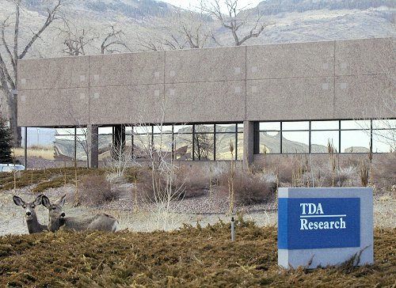
Carbon Capture Pilot at Dry Fork Power Station
Community Briefing
OCED Award: CD0000054
Gӧkhan Alptekin, Principal Investigator
David Gribble, Project Manager
Sara Rolfe, CBP Lead
November 14, 2024

Slide 2

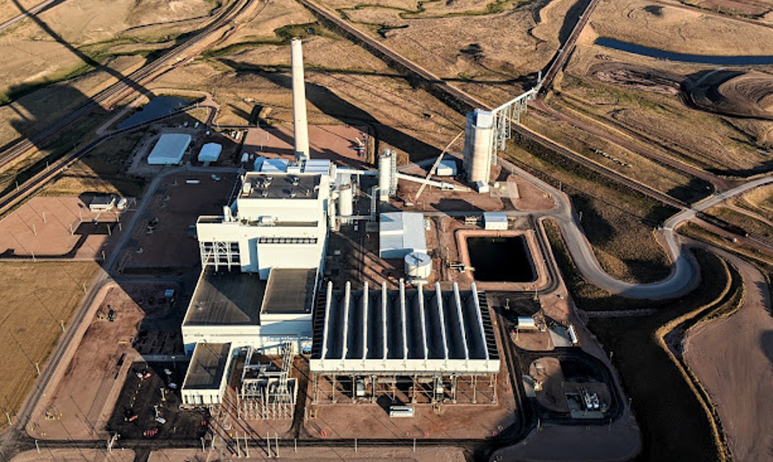
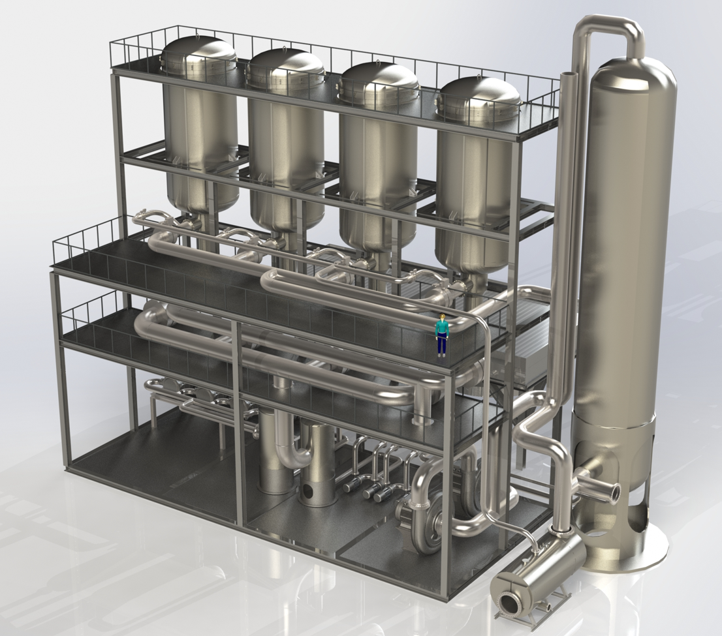
Project Summary
TDA and our partners plan to conduct a pilot-scale (≤ 23 MW_{e}) evaluation of an adsorbent-based carbon capture technology
The demonstration is being planned for the Wyoming Integrated Test Center (ITC) at Basin Electric’s Dry Fork Station with the following performance goals:
Up to 158,000 tonne/year of CO₂ will be captured with ≥ 90% capture efficiency
Produce a sequestration-ready CO₂ product (≥ 95% CO₂ purity)

Slide 3



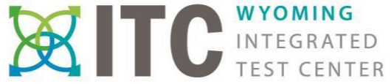




Project Partners
3

Slide 4
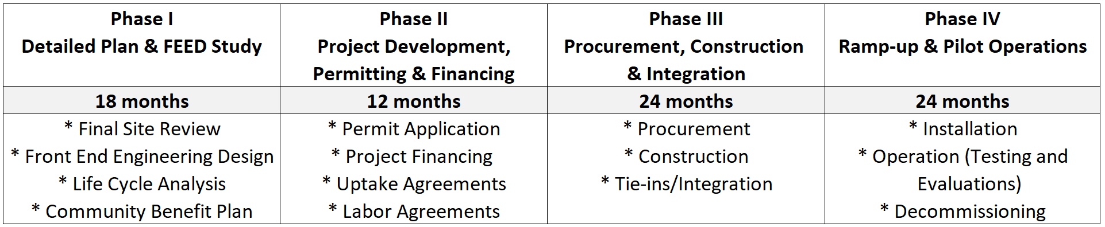
Project Schedule
The project is organized into 4 sequential phases with go/no-go stage gates:
Phase 1—Detailed Planning and FEED Study (Current Phase)
Phase 2—Project Development, Permitting, and Financing
Phase 3—Procurement, Construction, and Integration
Phase 4—Ramp-up, Pilot Operations, and Decommissioning
(Estimated Total Project Cost = $70 million with up to $49 million from federal funds)

Slide 5
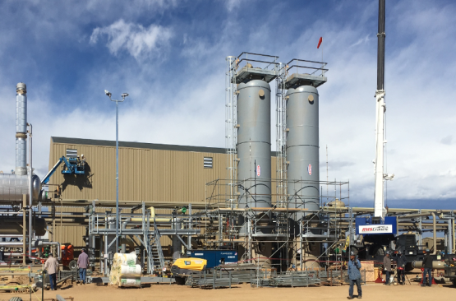
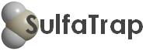
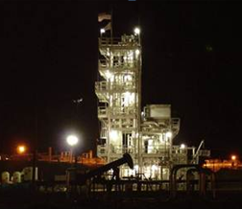
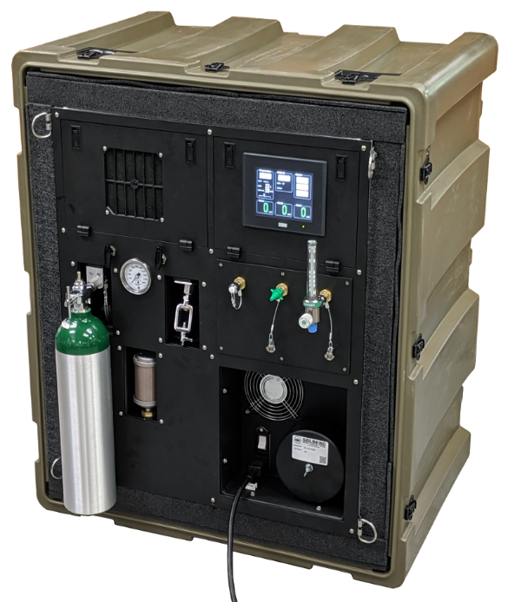
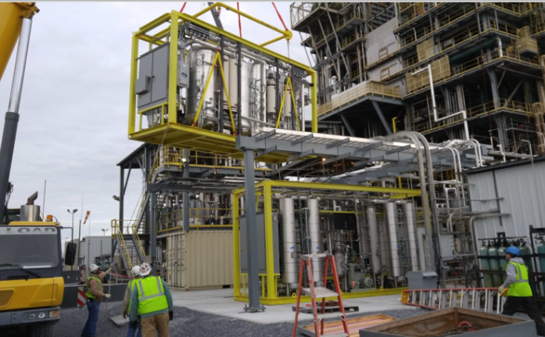

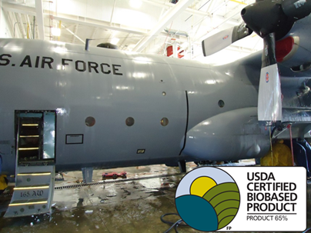
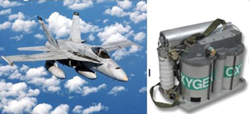
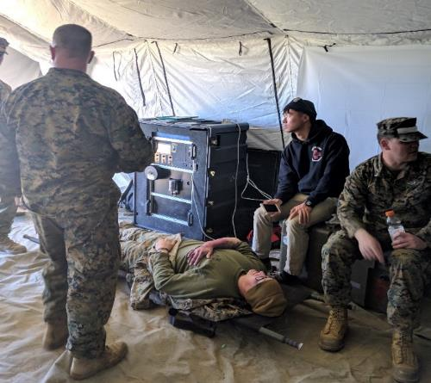
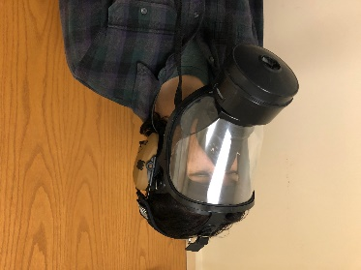
TDA Research, Inc.
Privately held R&D organization with 132 employees (34 PhDs)
$30.1 million revenue in 2023
Focus on early-stage R&D
Direct Catalytic
H₂S Oxidation Technology
SulfaTrap Purification Products
Fullerene Manufacturing
40 MT/year in Kitakyushu, Japan
Ambient Temperature CO/VOC Oxidation Catalyst
SSDX-12TM
Aircraft Detergent
Air Separation Sorbent for Medical Applications
Carbon Capture Technologies

Slide 6
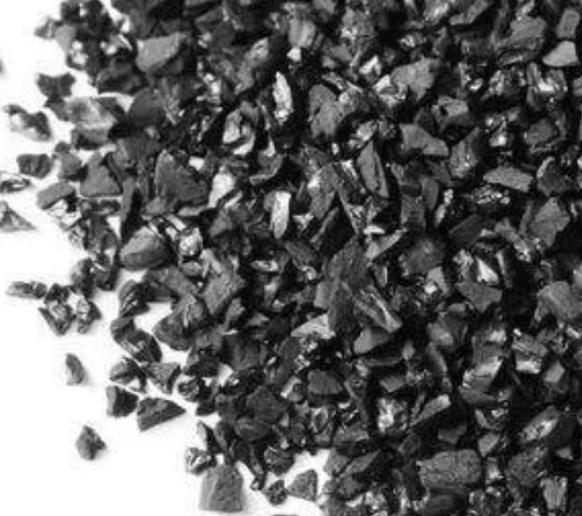
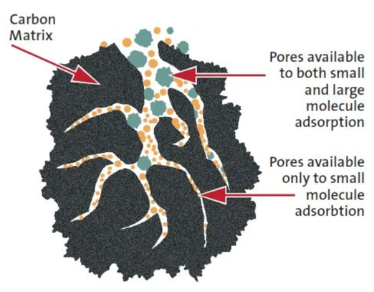
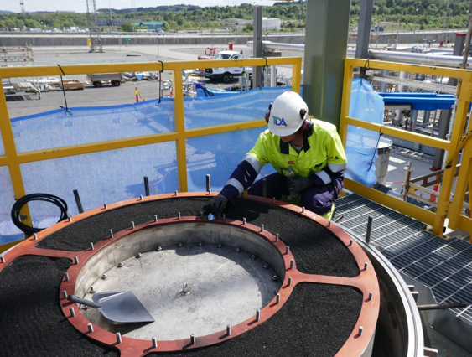
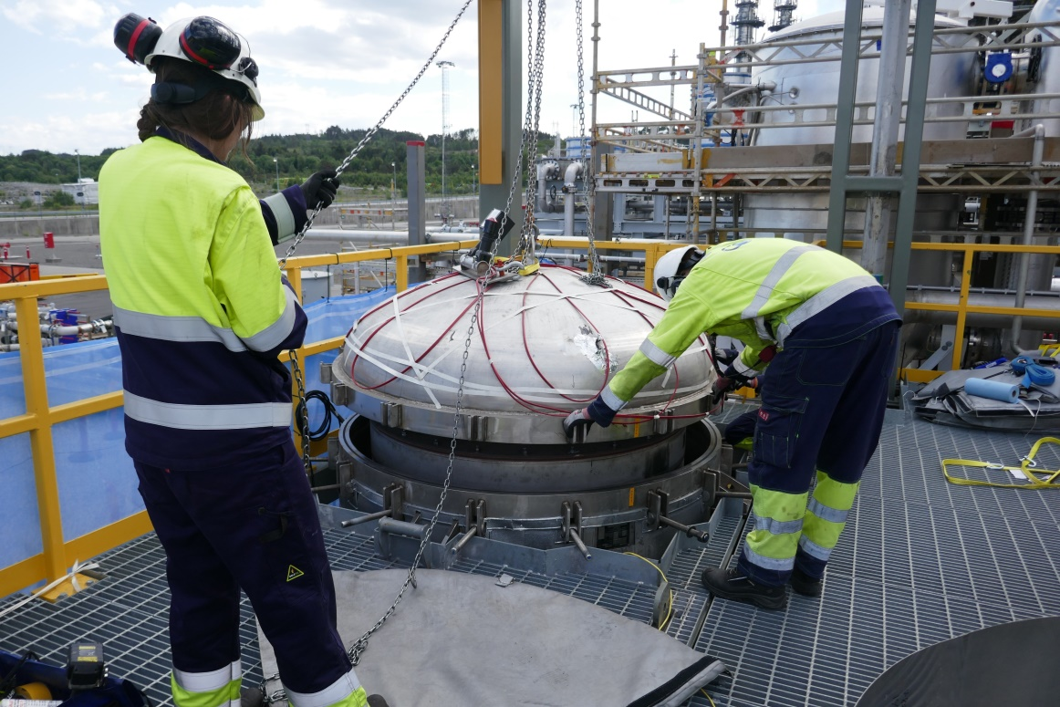
TDA’s CCS Technology
TDA uses a physical sorbent that removes CO₂ selectively from flue gas
The sorbent is a modified activated carbon with surface groups that improve CO₂ selectivity
The sorbent is a safe material derived from sugar or other biomass (e.g., starch)
The sorbent is porous like a sponge with large pores that improve flue gas access
No additional gas or water emissions products; all solid waste can be safely disposed

Slide 7
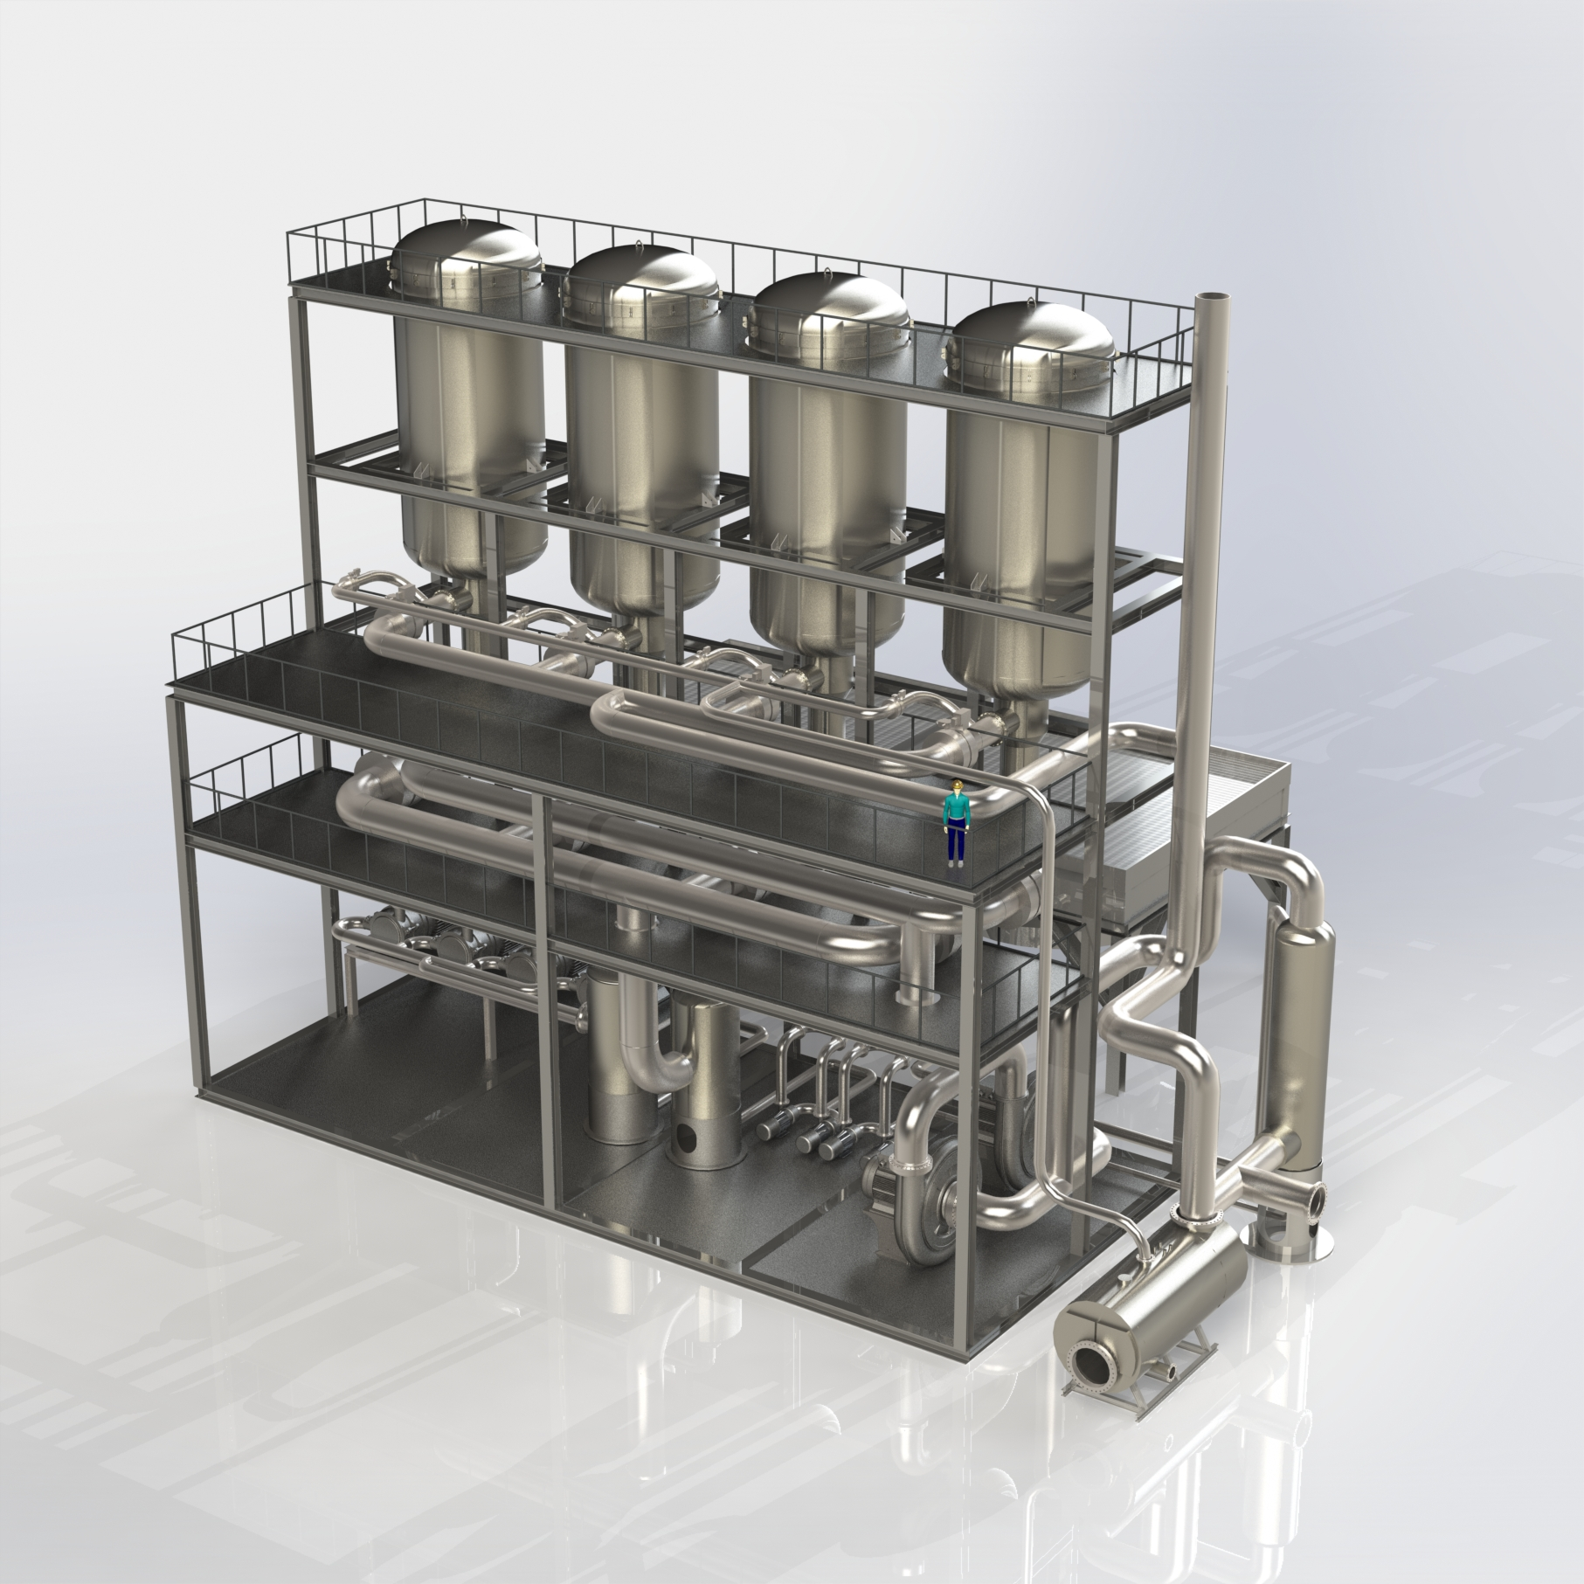
TDA’s VCSA-Based CO₂ Capture Process
Vacuum/Concentration Swing Adsorption
Before the stack, flue gas is cooled and passed through TDA’s adsorbent bed, which removes CO₂
When a bed is saturated, valves switch the stream to bring a new bed online
The saturated bed is regenerated with vacuum (≈150 mbar) and steam (≈1.5 mol steam / mol CO₂)
Multiple beds allows continuous operation
System generates all its own steam
TDA’s VCSA cycle doesn’t require water
VCSA Cycle
Gillette, Wyoming
Mongstad, Norway

Slide 8



TDA’s Sorbent
No new gas emissions or byproducts
Carbon sorbents are used worldwide in wastewater and drinking water treatment
TDA’s sorbents can be used continuously for years
Spent sorbent can disposed in suitable landfills or incinerated
Considered non-dangerous goods for transport
Safe to handle; standard PPE is recommended for personnel protection
Sorbent does not have special storage requirements
Sorbent is not volatile, explosive, corrosive, or toxic
Sorbent is not volatile, explosive, corrosive, or toxic
Basic respiratory protection is recommended for handling, but no other PPE is required
No occupational exposure limits or environmental regulations
Material is flammable at temperatures > 650°F
Emissions and Disposal
Transport and Handling
Hazard Analysis

Slide 9
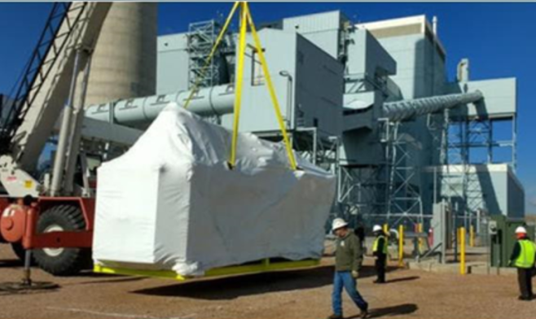
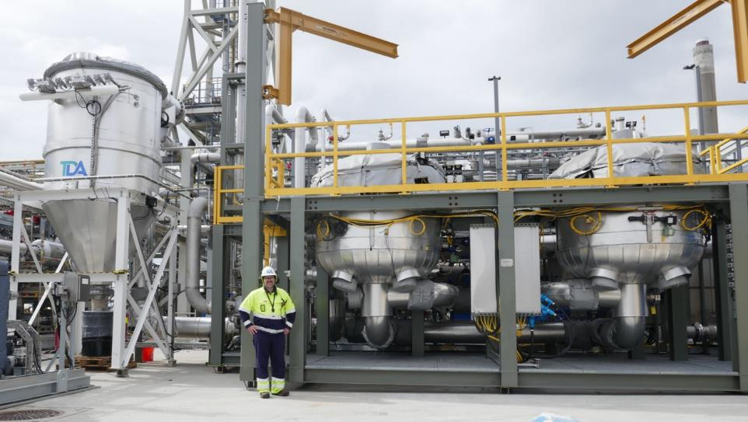
Technology Demonstrations/Validation
TDA has demonstrated this technology through fields tests:
Wyoming Integrated Test Center in Gillette, WY ( 50 kW) 2018–2020
Technology Centre Mongstad in Mongstad, Norway (1MW) 2021–2022
The objective of the overall project is to validate TDA’s CCS at a larger scale (23 MW)
In Phase I of this project, TDA will complete a front-end engineering design (FEED) study for the CCS and generate a workflow for permitting and the NEPA review process
Community engagement is a key component of TDA’s work plan and will be included in all phases of the project
Gillette, Wyoming
Mongstad, Norway

Slide 10
Community Benefits Plan
TDA CBP Lead: Sara Rolfe, communitybenefits@tda.com, (303) 940-5381
Consultant: University of Wyoming’s School of Energy Resources (SER)
TDA's CBP website: https://tda.com/community-benefits-home
Community Advisory Board: Planned for Phases 2–4; nominate members
Community Engagement: We will establish two-way conversations with neighboring communities, tribal groups, labor unions, and workforce organizations
Social Characterization Analysis and Stakeholder Mapping
Public events
Tribal engagement
Private meetings
Gillette, Wyoming
Mongstad, Norway

Slide 11
Community Benefits Plan
DEIA Training, Internships, Seminars
Partnerships
Local colleges or Minority Serving Institutions (MSI)
Workforce development and unions
Community leaders and government
Workforce and Community Agreements
Labor and Workforce Development Plan
Energy and Environmental Impact—Emissions and Effluent Report
Justice40 Implementation Strategy—Analyze benefits and negatives
Gillette, Wyoming
Mongstad, Norway

Slide 12
Questions from Previous Community Briefings
What will happen to the carbon captured in this demonstration?
What proof do you have that the sequestered carbon can be stored safely underground in the delineated site?
Are there any existing carbon capture projects that have successfully captured carbon at the rate planned in this demonstration?
What is the lifecycle of the sorbents used? How are they made? How long do they last? How are they disposed of?
How much water will you use in this process? Where does it come from?
How will this pilot plant impact the cost of power to ratepayers?
Is the technology scalable to capture ≥ 75% of the carbon emissions at the plant?
Can this technology, or any technology, capture 100% of the carbon emissions at the plant?
Questions from audience?
Gillette, Wyoming
Mongstad, Norway

Slide 13
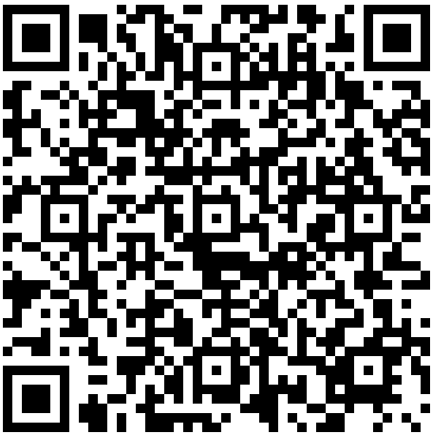
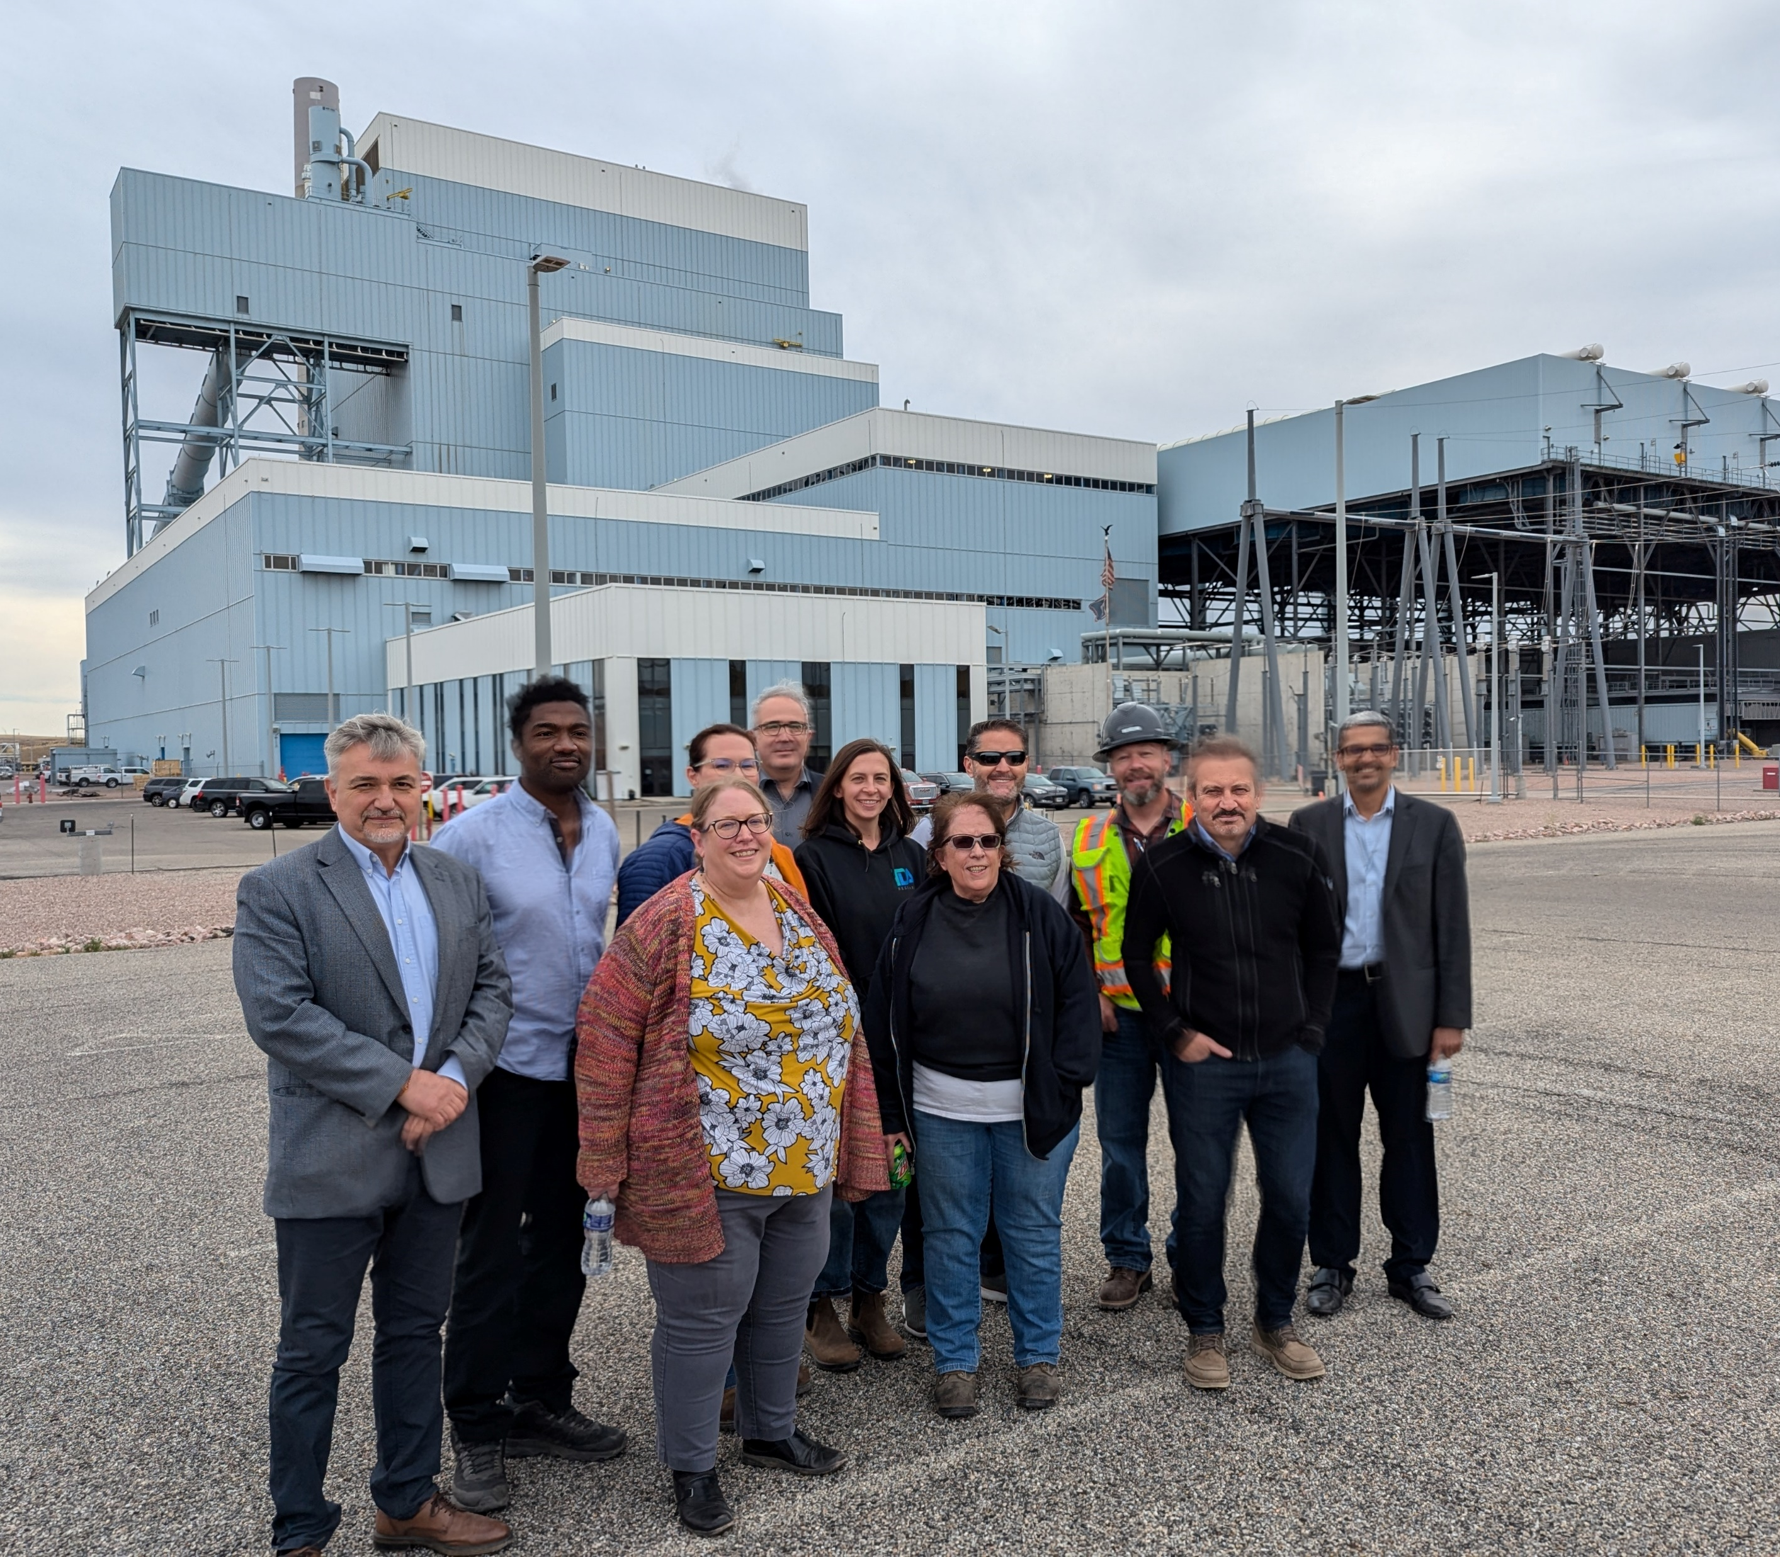
Feedback – Let us know what you think!
Sara Rolfe, TDA CBP Lead
communitybenefits@tda.com
(303) 940-5381
https://tda.com/community-benefits-home
Gillette, Wyoming
Mongstad, Norway

